Slide 1


Financial Transactions
Analysis
Eng. Rahma Mohamed Abdelfattah

Slide 2

Project Overview
Dataset: Kaggle Link
Shape: 13,305,915 rows × 22 columns
Key Features:
Transactional: id, date, amount, merchant info, errors
Customer: client_id, age, gender, income, debt, credit_score
Card: card_id, brand, type, limit, chip usage
Target: fraud_label

Slide 3

Table of
Contents
01
Data Preprocessing
& Cleaning
02
Data Analysis
03
Power BI
Dashboard

Slide 4

01. Data Preprocessing & Cleaning
Standardized transaction values, handled missing data, optimized data types, and engineered new features to ensure dataset quality and analytical readiness.

Slide 5
Data Preprocessing – Transaction Amount
Initial Issue: amount column stored as strings with currency symbols ($)
Step 1: Removed $ signs from all values
Step 2: Converted column to numeric type
Financial Interpretation:
Positive values = Credits (inflows to account)
Negative values = Debits (outflows)
Feature Engineering:
credit_amount → captures positive inflows
debit_amount → captures absolute value of outflows
Impact: Ensured transaction amounts are usable for analysis and separated spending vs. refunds

Slide 6
Data Preprocessing – Dates & Age
Converted all dates into standard datetime format for time-series analysis
Restricted dataset to realistic customer ages (18–100 years)
Introduced age groups for better demographic segmentation:
18–25 | 26–35 | 36–45 | 46–55 | 56–65 | 65+
Impact: Prepares the data for trend analysis, fraud distribution by age, and customer profiling

Slide 7
Handling Missing Values
Extent of Missing Data
Merchant State: 1.56M missing
ZIP: 1.65M missing
Errors: 13.09M missing (≈98.4%)
Fraud Labels: 4.39M missing (≈33%)

Slide 8
Handling Missing Values
Handling Strategy
Merchant State / ZIP → filled with “Unknown”
Errors → treated as “No Error” (absence = successful transaction)
Fraud Labels → marked as “Unlabeled”, preserving 33% of data for potential semi-supervised analysis
Key Findings
Fraud label missingness is random, not systematic
Avg. Amount: 43.03 (Missing) vs 42.95 (Non-Missing)
Avg. Credit Score: 713.88 (Missing) vs 713.93 (Non-Missing)
No meaningful bias between missing and complete records

Slide 9

02. Data Analysis
Explore customer demographics, transaction behaviors, and fraud patterns.

Slide 10
Key Metrics
Total Transactions: 13M
Total Customers: 1,218
Credit Amount: 638.79M
Debit Amount: 67M
Average Transaction: 43.00
Average Credit Score: 713.86

Slide 11
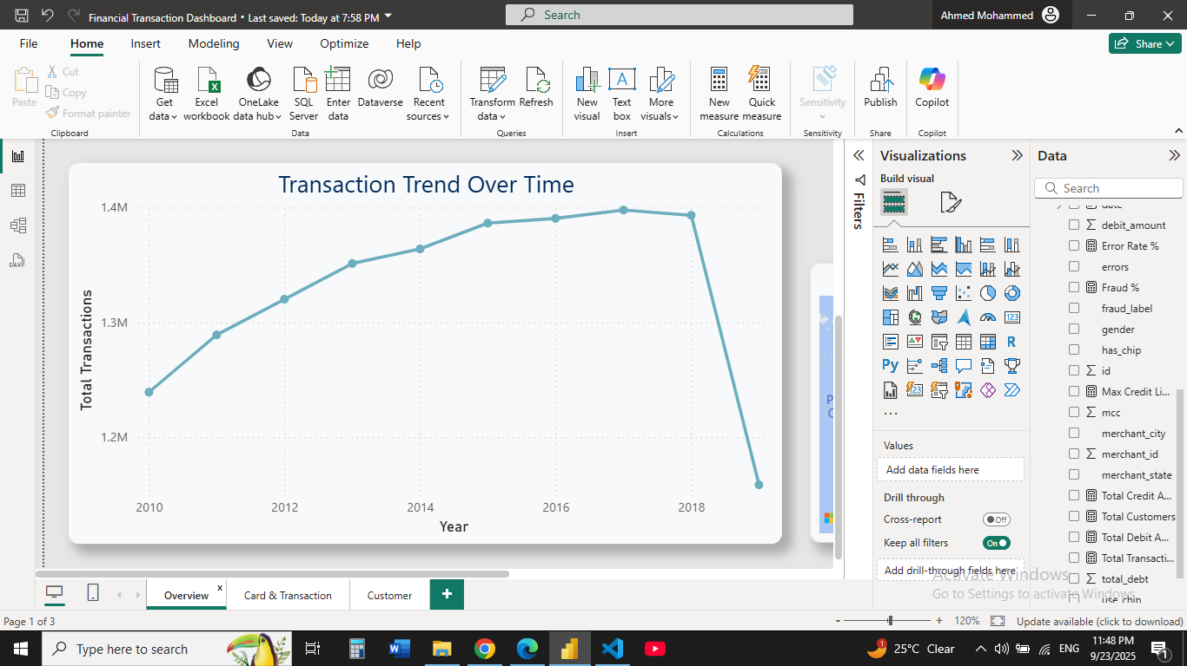
Transaction Trends
Average credit vs. debit amounts:
Credit Amount: 638.79M
Debit Amount: 67M
credit transactions dominate.
Strong growth from 2010 to 2016, slight plateau afterward, then sharp decline post-2018.
Insights: Potential changes in customer behavior or system changes after 2018.

Slide 12
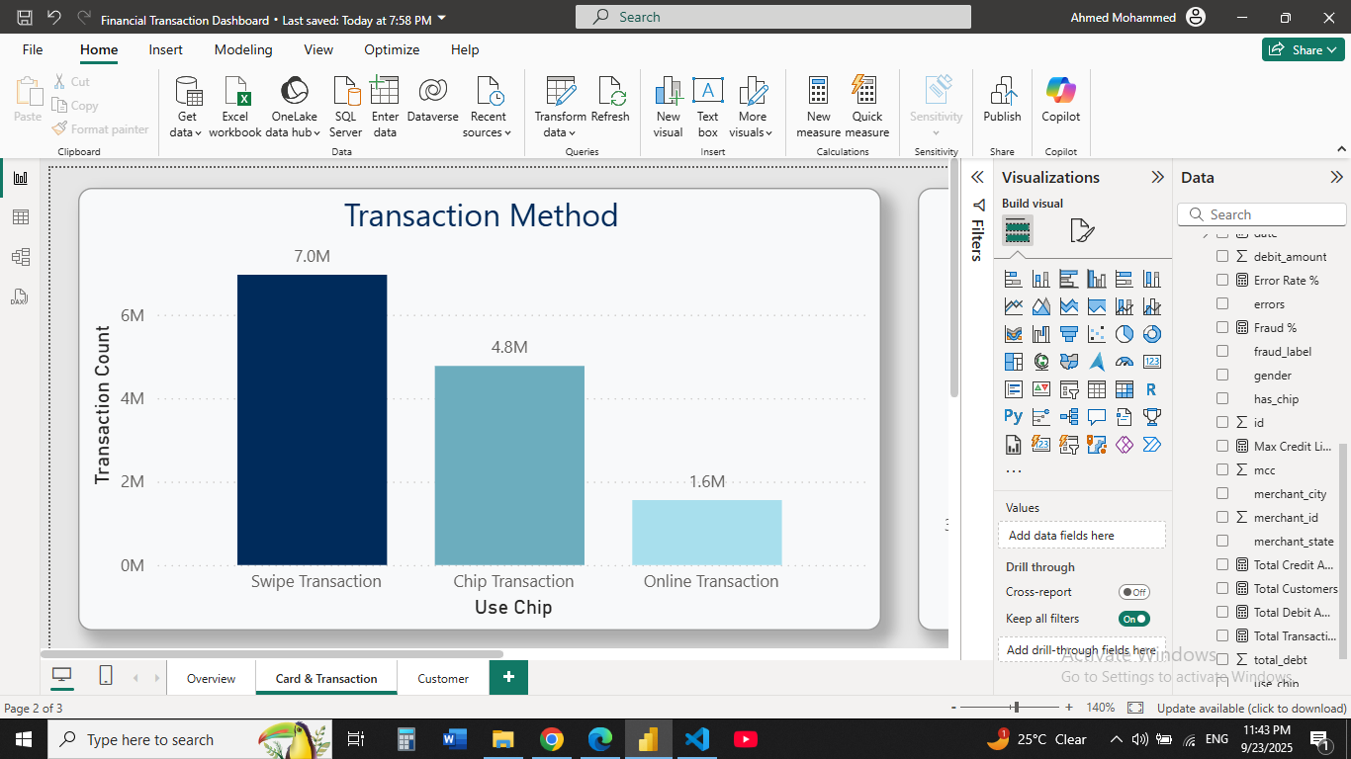
Transaction Methods
Swipe Transactions: 7.0M
Chip Transactions: 4.8M
Online Transactions: 1.6M
Swipe still dominant; chip adoption growing.
Suggests opportunities for promoting safer online/chip transactions.

Slide 13
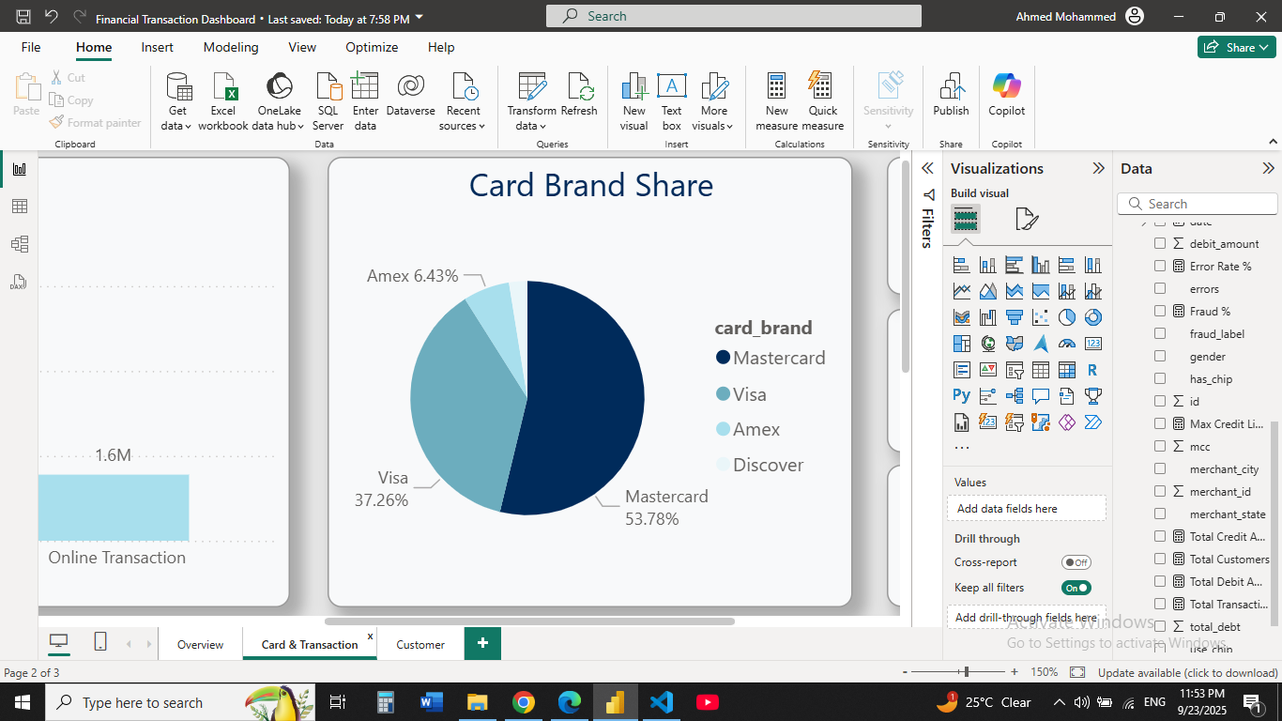
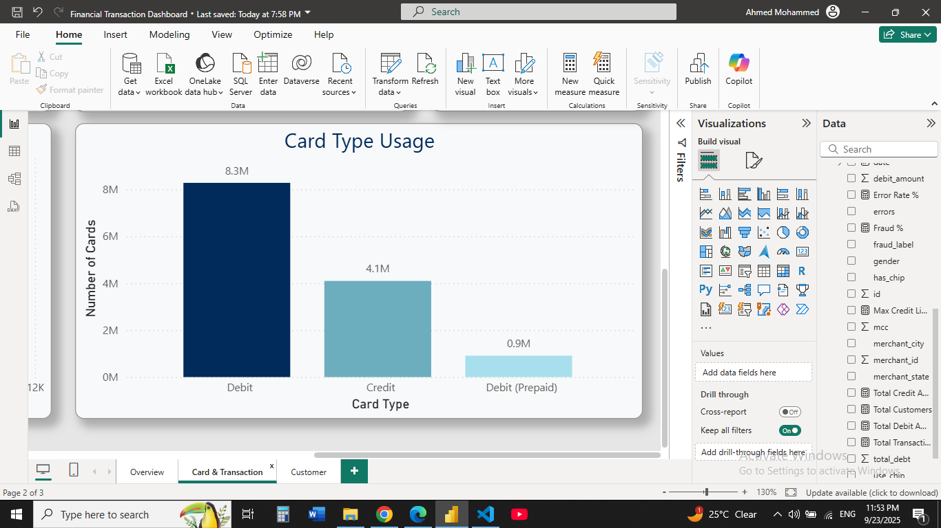
Card Brand & Type Usage
Card Type Usage:
Debit cards most used (8.3M)
Credit cards (4.1M)
Prepaid debit (0.9M)
Card Brand Share:
Mastercard (53.78%)
Visa (37.26%)
Amex (6.43%)
Discover (2.53%)
High debit usage indicates customers may prefer direct spending over credit.

Slide 14
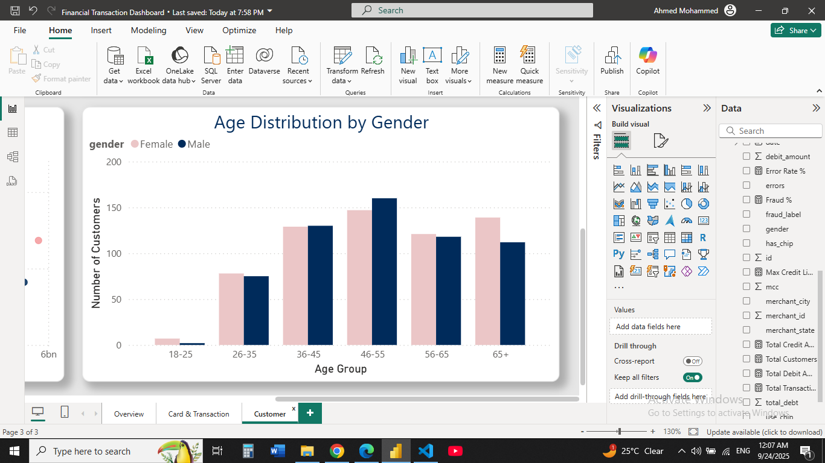
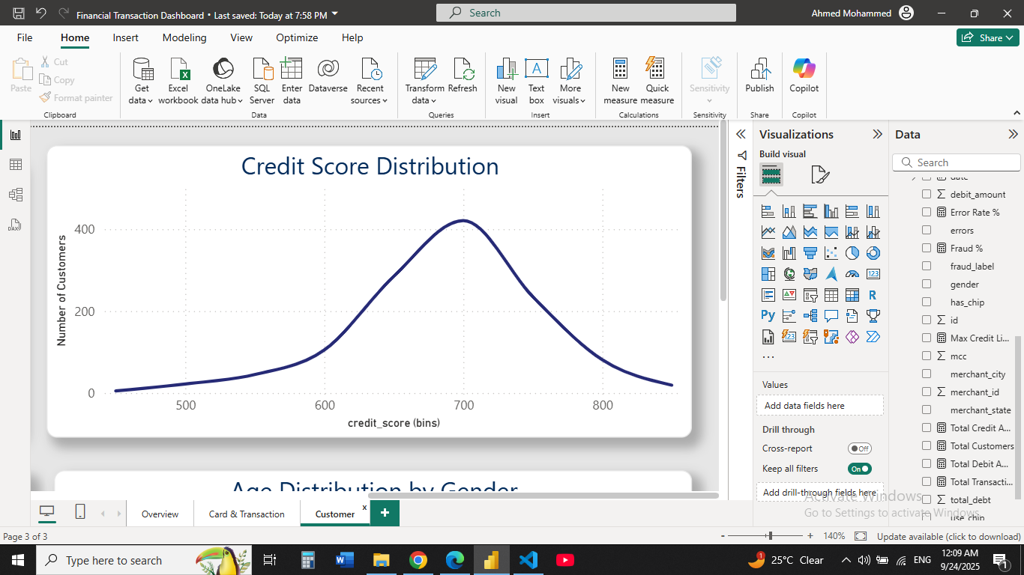
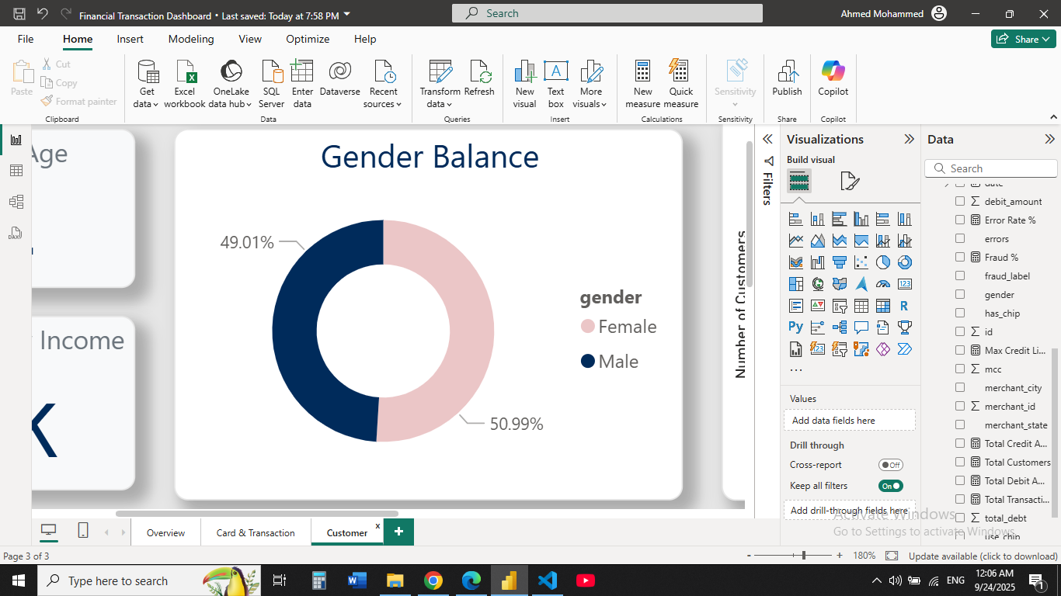
Customer Demographics
Average Age: 54
Average Yearly Income: 47K
Gender Balance: ~51% male, ~49% female.
Age distribution peaks at 36–55.
High credit scores clustered around 700–750.

Slide 15
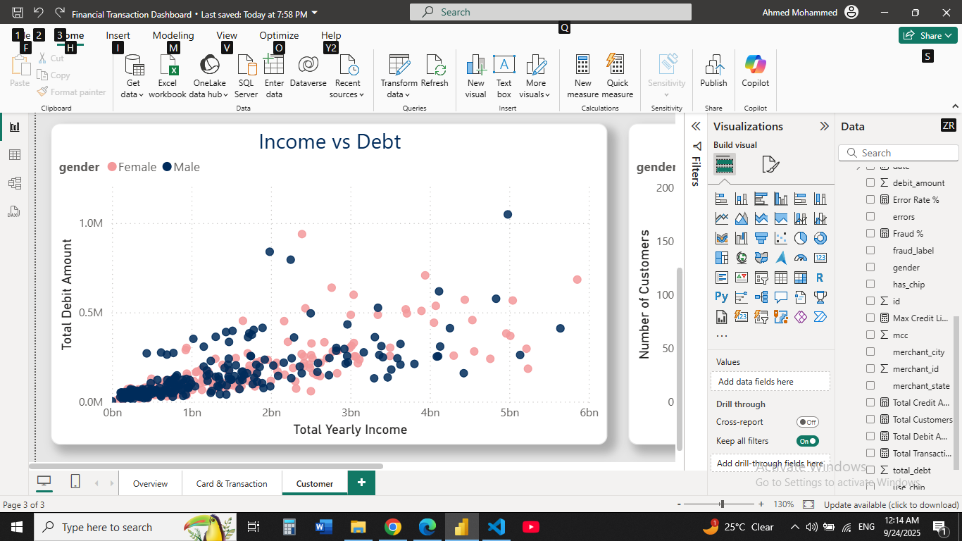
Income vs Debt
Scatter plot shows wide spread of debt across incomes.
Some high-income customers carry large debts, potential credit risk.
Opportunity to segment high-debt customers for targeted risk evaluation.

Slide 16
Fraud & Errors Analysis
Fraud Rate: 0.15%
Error Rate: 1.58%
Most common errors: Insufficient Balance, Bad PIN, Technical Glitch.
33% of fraud labels missing but no bias detected (random missingness).
Insight: Focus fraud detection models on labeled data, while exploring semi-supervised methods for unlabeled cases.

Slide 17
Key Takeaways & Recommendations
Customer Profiling: Middle-aged, balanced gender, high debit card usage.
Spending vs Repayment: Majority use debit, but high-income customers with high debt may represent risk.
Fraud Detection: Low fraud rate but large unlabeled segment; consider improved labeling or anomaly detection.

Slide 18

03. Power BI Dashboard
Interactive visuals for exploring fraud patterns, customer demographics, and transaction trends.

Slide 19
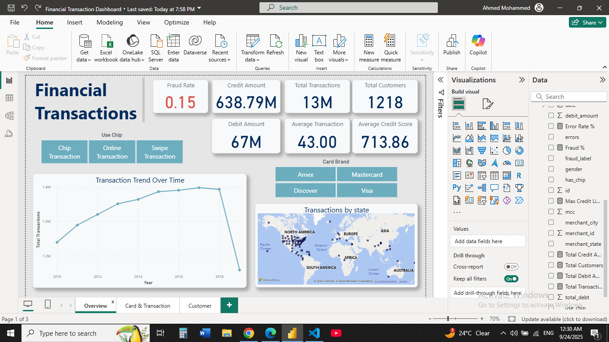

Slide 20
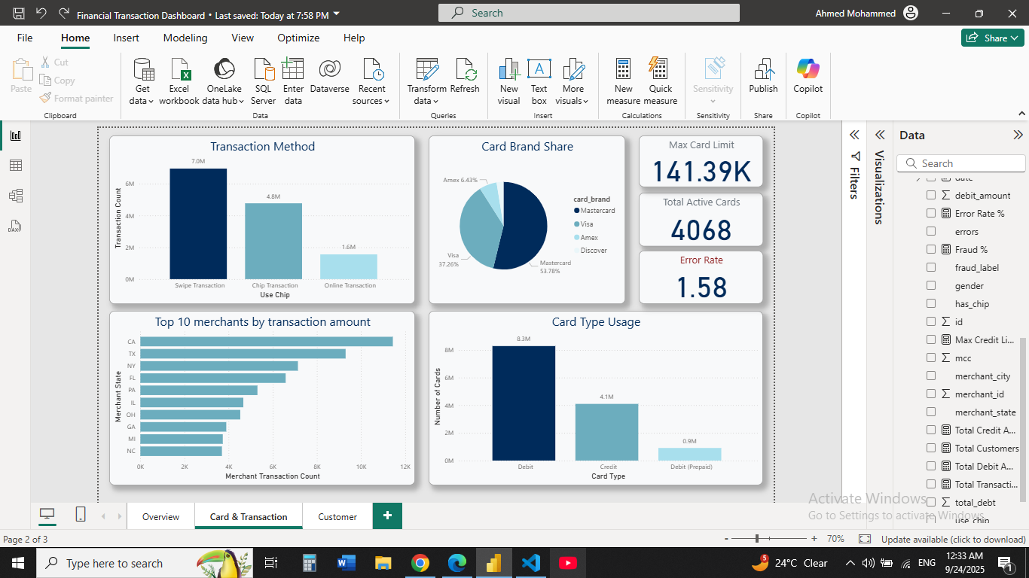

Slide 21
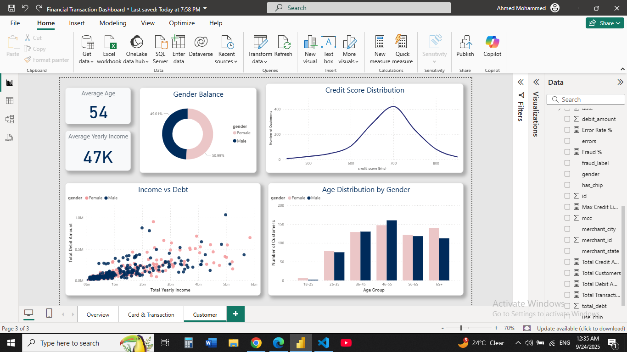

Slide 22

GitHub Repo
Power Bi Dashboard

